Slide 1




Development of master curricula for natural disasters risk management in
Western Balkan countries
NatRisk
Cooperation with non-academic sector
Dejan Rančić
University of Niš, Faculty of Electronic Engineering
Training of teaching staff for innovative teaching methods/ 19th to 21st September 2017.
Project number: 573806-EPP-1-2016-1-RS-EPPKA2-CBHE-JP
"This project has been funded with support from the European Commission. This publication reflects the views only of the author, and the Commission cannot be held responsible for any use which may be made of the information contained therein"

Slide 2
Cooperation with non-academic sector
Development of master curricula for natural disasters risk management in Western Balkan countries
This presentation presents cooperation between University of Nis and Hydro-meteorological Service in Serbia as well as with Ministry of Defense.
Starting from 1996. these two institutions collaborate on developing HAil Protection Information System – HASIS
The developed system is in operational use starting from 2000, and the system plays key role in hail suppression activities in Serbia.
Starting from 2009, the University of Nis collaborates with Ministry of Defense in order to develop GIS for natural hazards prevention.

Slide 3
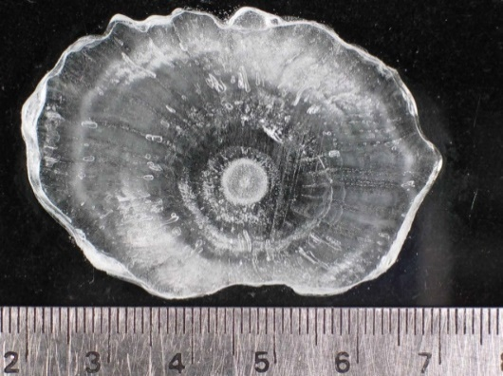
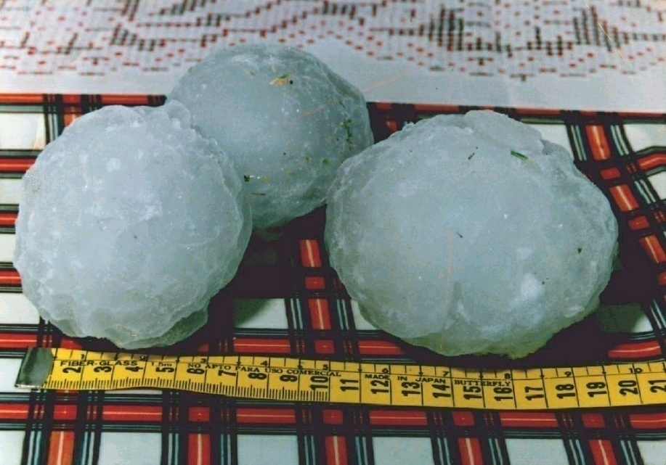
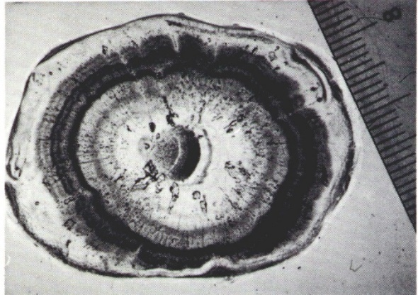
Hail in Serbia
Development of master curricula for natural disasters risk management in Western Balkan countries
Hail is a frequent meteorological fenomena in Serbia: 30 to 50 days per year.
Highest intensity during the period: May –July.
Diameter of hailstones in most cases is about 15 mm.

Slide 4
Hail Suppression in Serbia
Development of master curricula for natural disasters risk management in Western Balkan countries
77,498 km² TOTAL AREA
51,069 km² AGRICULTURAL AREA
13 RADAR CENTERS
1,800 HAIL SUPPRESSION STATIONS
250 FULL TIME WORKERS
3600 VOLUNTEER WORKERS ON LAUNCHING SITES

Slide 5
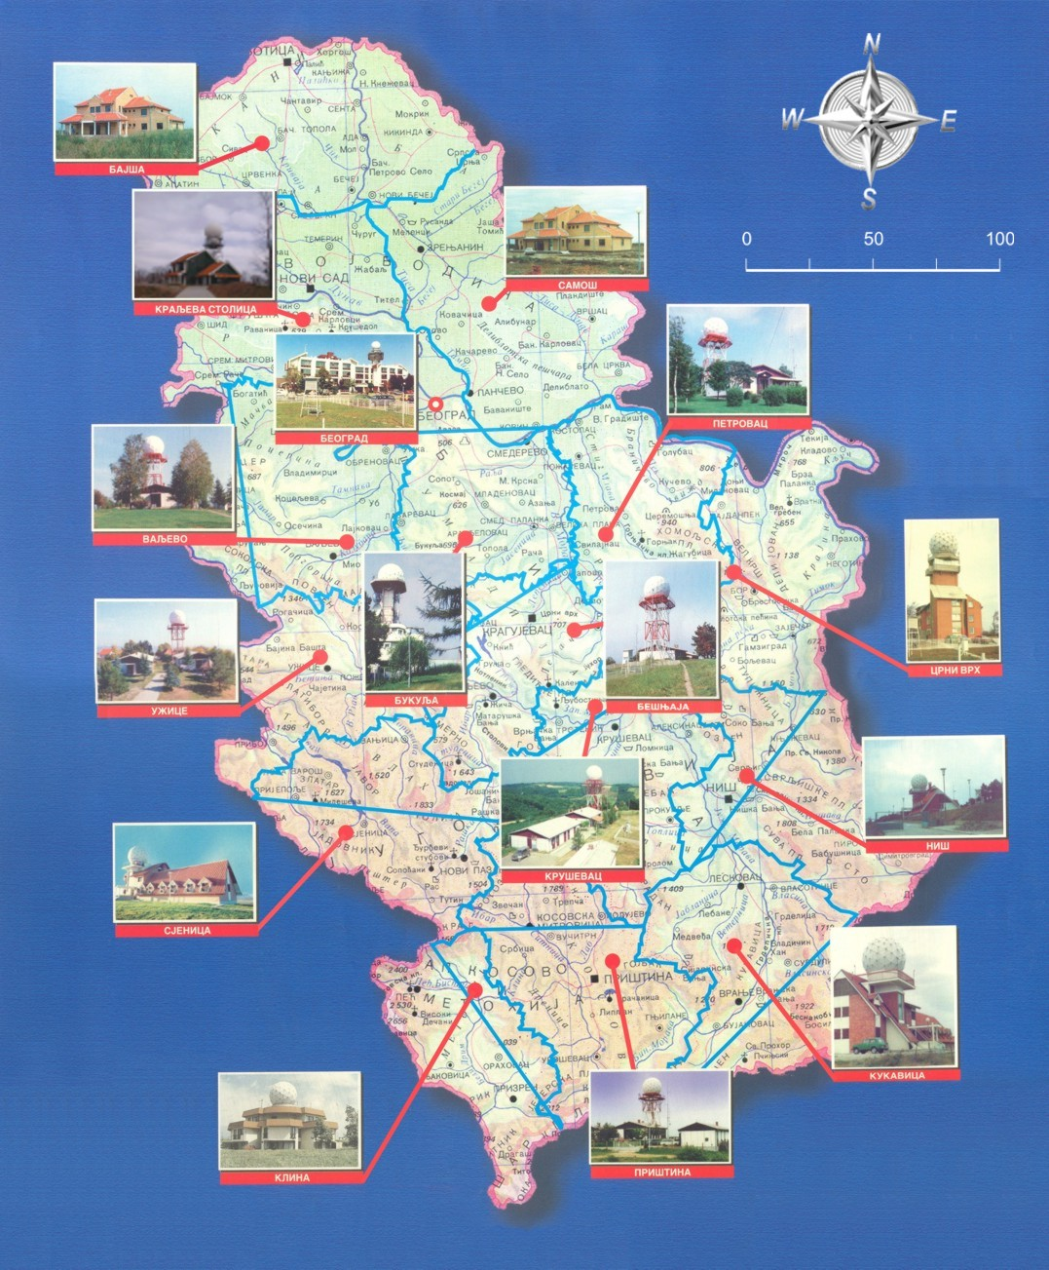
RADAR CENTERS IN SERBIA

Slide 6
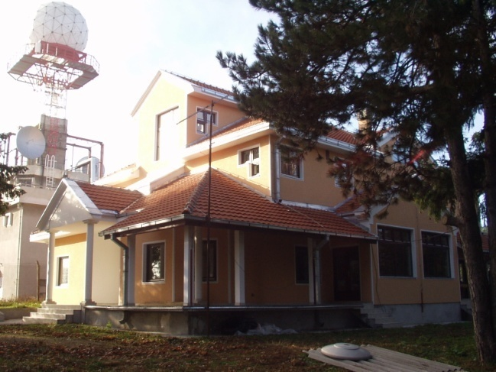
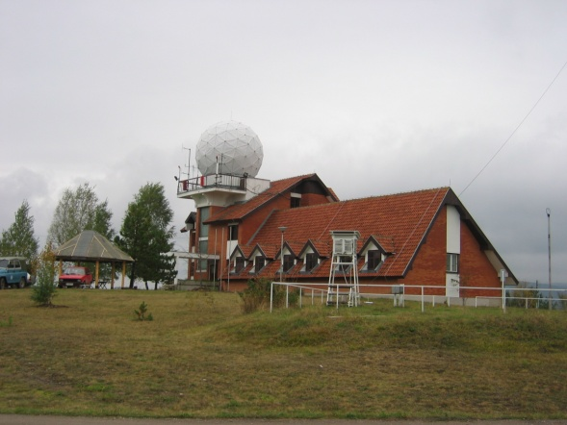
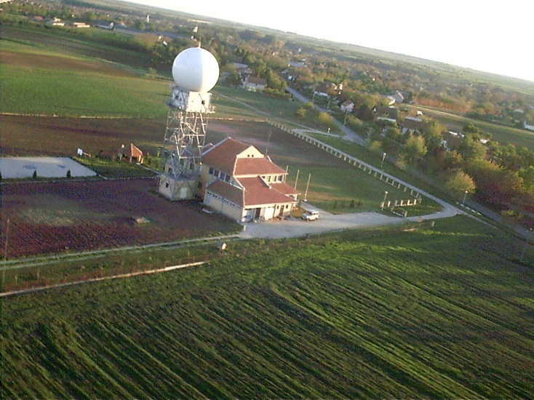
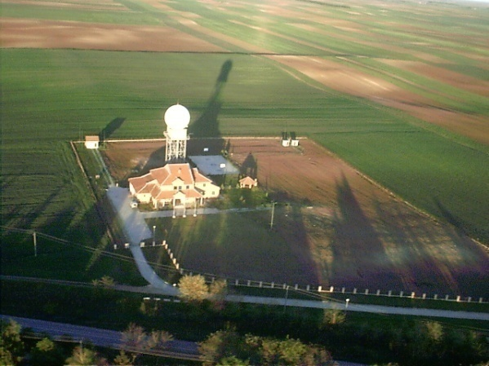
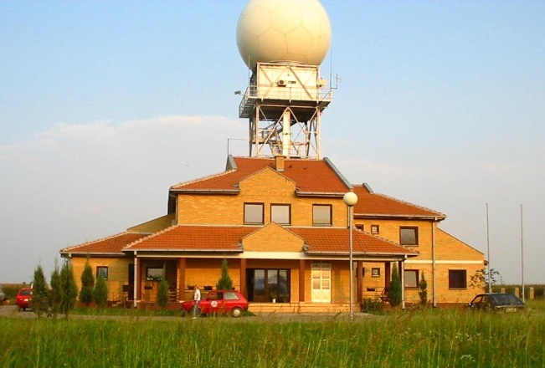
Development of master curricula for natural disasters risk management in Western Balkan countries
Radar centers in Serbia

Slide 7
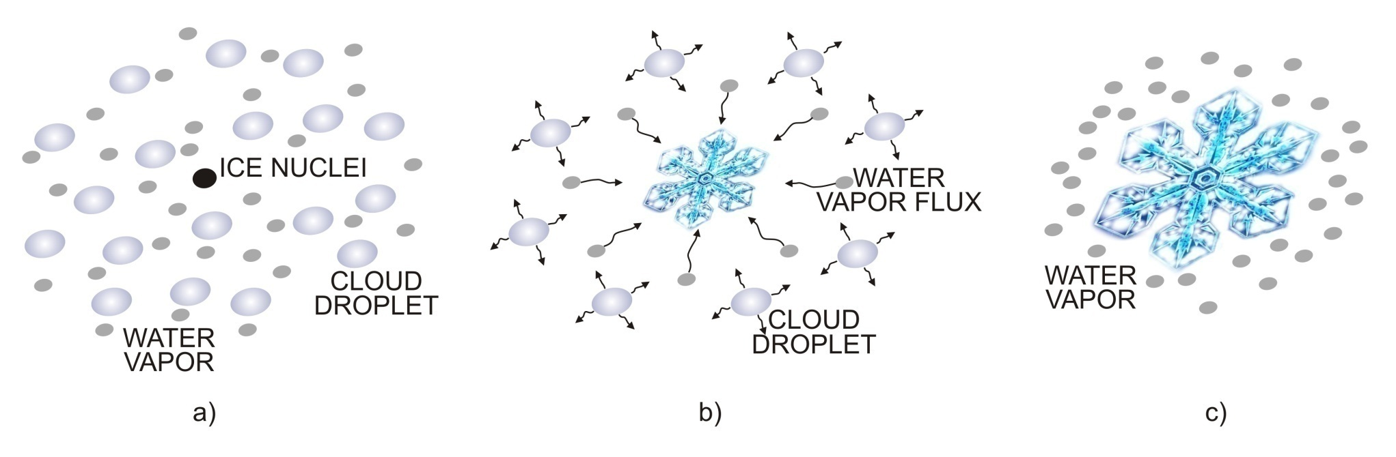
Development of master curricula for natural disasters risk management in Western Balkan countries
How water becomes hail?
The ice crystal growth process.

Slide 8
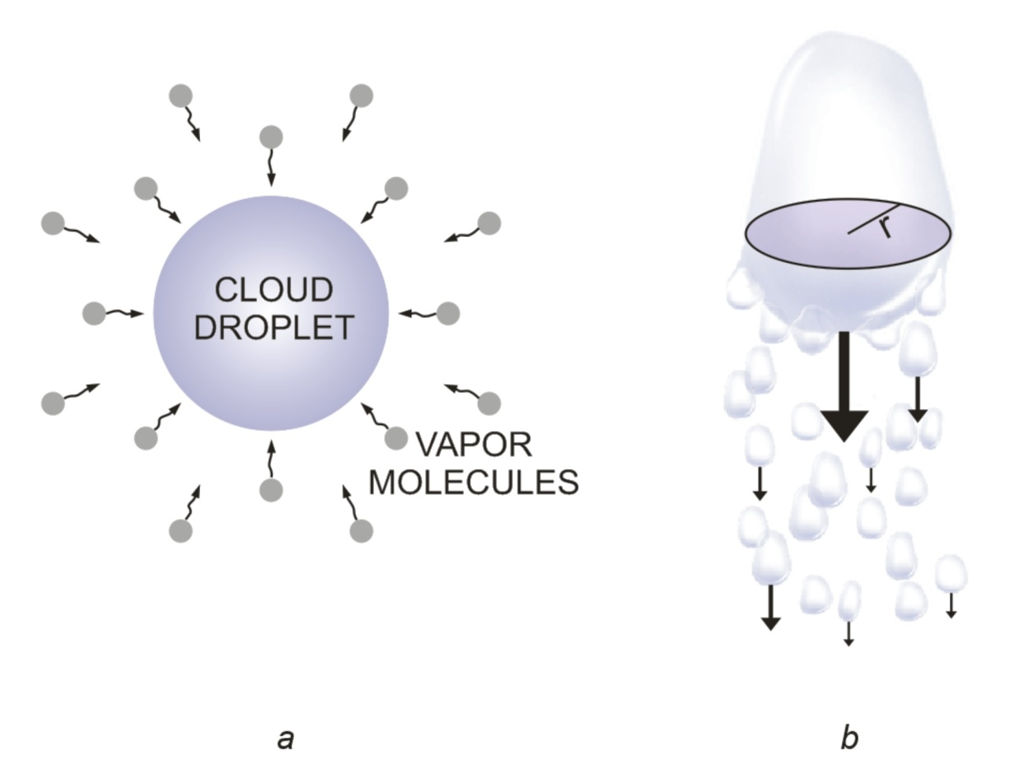
Development of master curricula for natural disasters risk management in Western Balkan countries
Why cloud seeding?
Because we prefer rain instead of hail….

Slide 9
Development of master curricula for natural disasters risk management in Western Balkan countries
Why cloud seeding?
Any attempt to change the weather by direct applications of energy artificially produced by men has no chance of success, because it is still so vast;
The cheap weather modification methodology must involve the modulation of the release of energy already stored in the atmosphere or the modification of radiative energy transfer;
A way to accomplish the later would be seeding of the clouds.

Slide 10
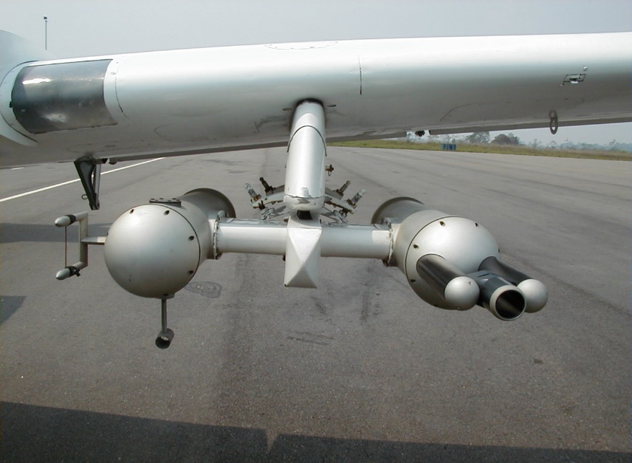
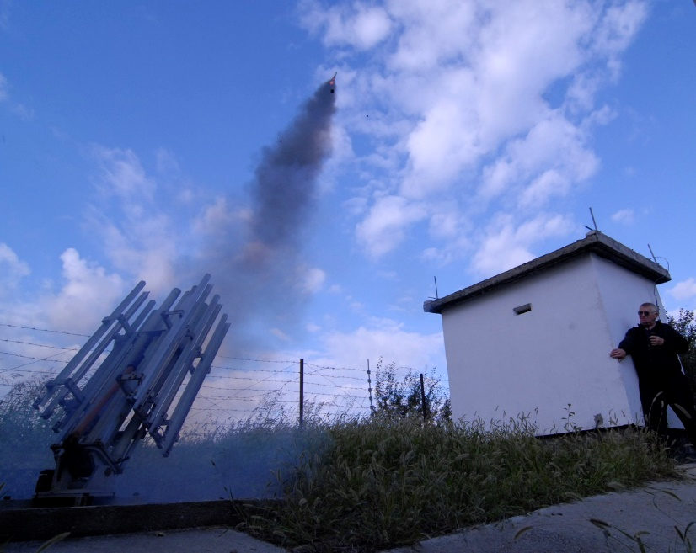
Development of master curricula for natural disasters risk management in Western Balkan countries
Methodologies for cloud seeding
Instrumented air plain.
Launching of hail rocket from the ground based rocket launcher

Slide 11
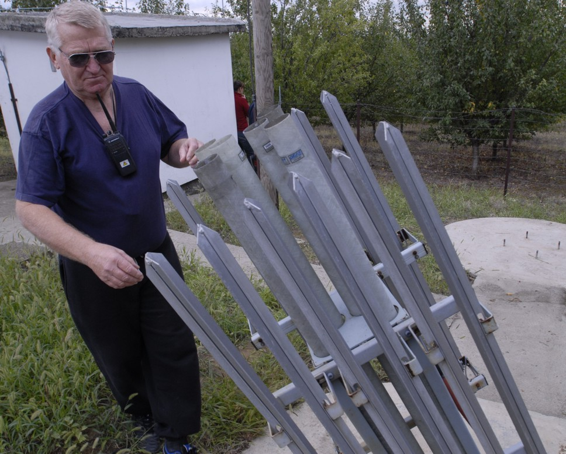
Development of master curricula for natural disasters risk management in Western Balkan countries
Methodologies for cloud seeding
In Serbia, the used methodology is cloud seeding with silver-iodide droplets by rockets.

Slide 12
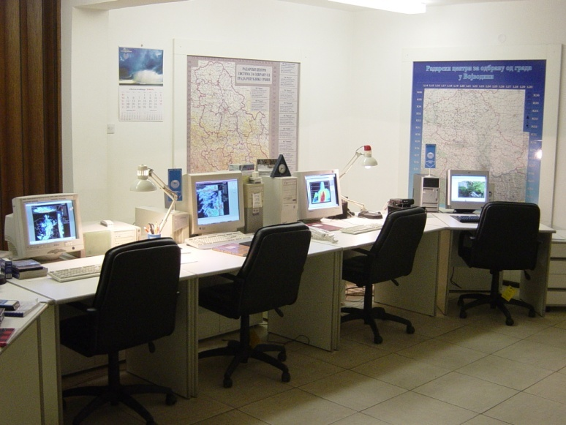
Development of master curricula for natural disasters risk management in Western Balkan countries
Where and when to seed?
For these decision the system HASIS which was developed by University of Nis, Faculty of Electronic Engineering is used.

Slide 13
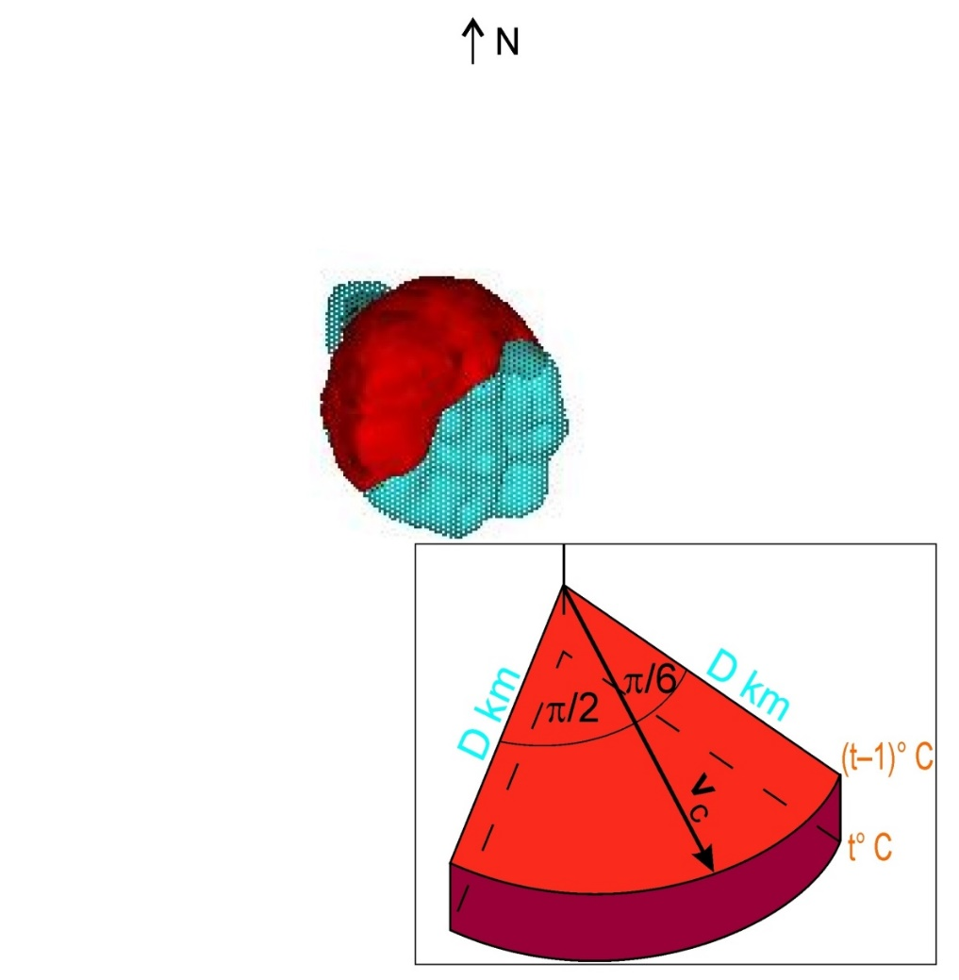
Development of master curricula for natural disasters risk management in Western Balkan countries
Where to seed?
56
(km)
0
(km)
56
The shape of the seeding zone depends on the seeding criteria.

Slide 14
Development of master curricula for natural disasters risk management in Western Balkan countries
HASIS
The main task of hail suppression system is efficient seeding of potentially hail containing clouds. The estimation whether the cloud is potentially hail containing or not is made by tracking the development of cloud systems. Three-dimensional Hail Suppression Information System (HASIS-3D), provides tracking and measurement of specific parameters of cloud systems.
Cloud tracking is enabled by efficient visualization of radar data. The data being used by the system is acquired using meteorological radars and represents cloud reflectivity for electromagnetic waves.

Slide 15
Development of master curricula for natural disasters risk management in Western Balkan countries
HASIS - Hail Suppression Information System
RADAR
RADAR WORKSTATION
•
CLOUD MONITORING & TRACKING
•
CLOUD PARAMETER EXTRACTION & HAIL PROBABILITY
ESTIMATION
DSP card
GIS WORKSTATION
•
ETHERNET - LOCAL AREA NETWORK
GIS FUNCTIONS
•
ROCKET LAUNCHING PARAMETERS CALCULATION
•
COORDINATION WITH COMMAND CENTER
•
SPATIO-TEMPORAL DATA MANAGEMENT
DATABASE WORKSTATION
•
data com.
LAUNCHING COMMANDS GENERATION
•
COORDINATION WITH HSS
MICROWAVE
LINK

Slide 16
Development of master curricula for natural disasters risk management in Western Balkan countries
HASIS – Basic functionalities
Detection of cumulo-nimbus clouds with high probability
Accurate measurements of all relevant parameters of hail cells in clouds
Calculation of launching elements (azimuth, elevation and timing) for rockets with seeding material
Determination of suitable HSSs with high degree of efficiency

Slide 17

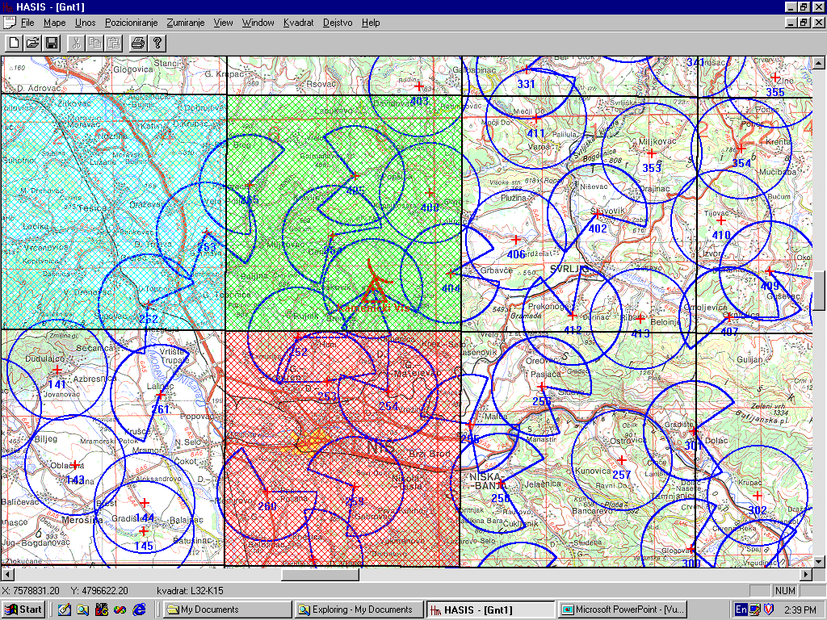
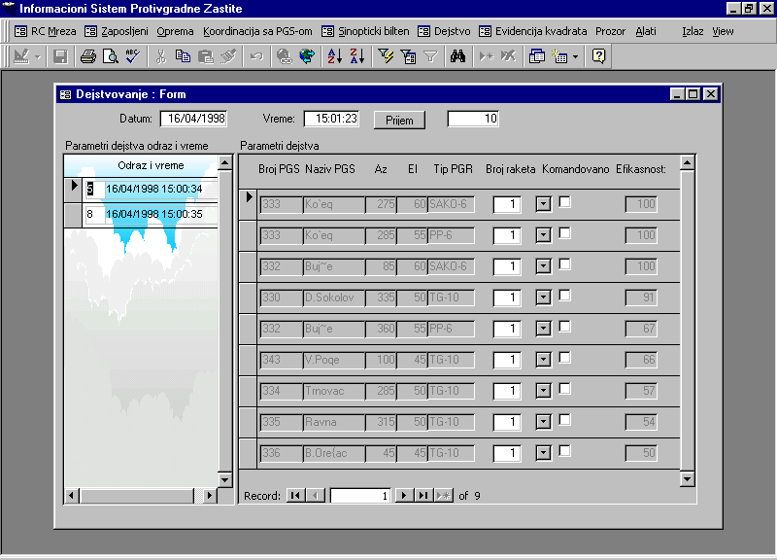
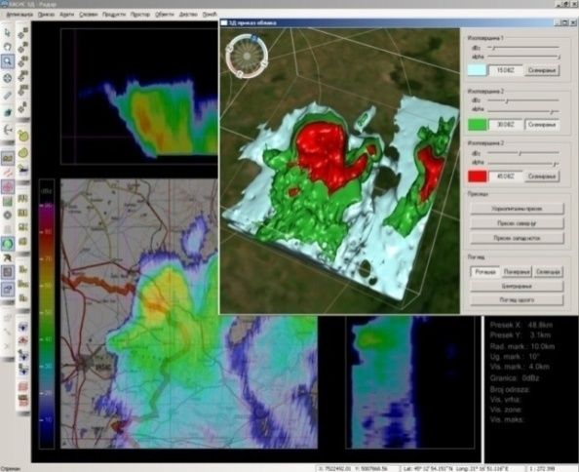
Development of master curricula for natural disasters risk management in Western Balkan countries
HASIS – Basic architecture
GIS Workstation
This workstation accepts the forwarded iso-contour, georeferences it and visualizes it on the geographical map. The main task of this workstation is to calculate ballistic elements for launching rockets with chemical reagent, to optimally seed the extracted iso-contour.
Database Workstation
This workstation stores the results of seeding process. These include data about ballistic parameters of rockets, location and availability of the launching station and the rockets.
Main Workstation
This workstation acquires cloud reflectivity products, maps it into the coordinate system of the corresponding geographic area and performs 2D/3D visualization and analysis.
Ethernet

Slide 18
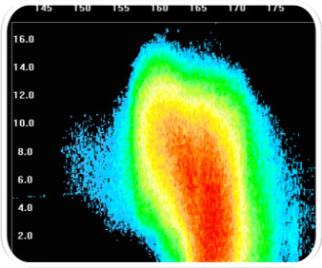
Development of master curricula for natural disasters risk management in Western Balkan countries
HASIS – cloud seeding methodology

Slide 19
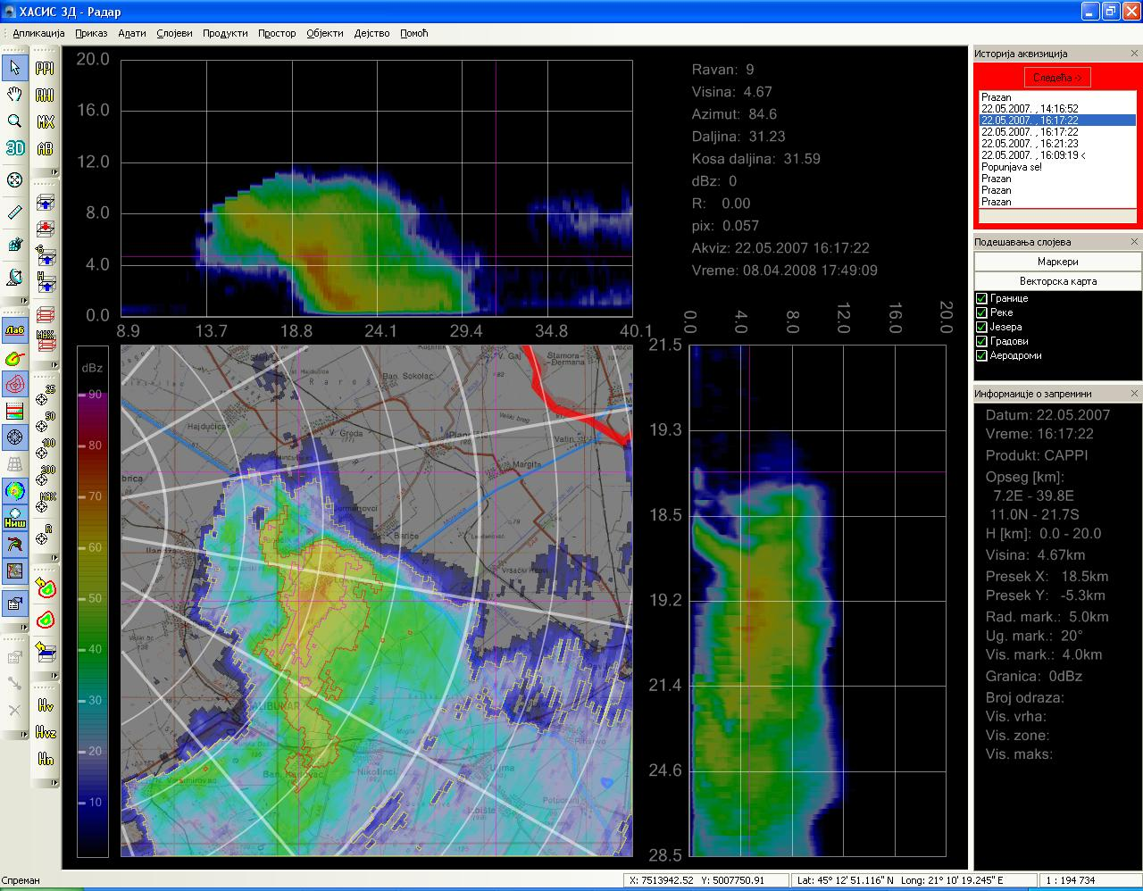
Development of master curricula for natural disasters risk management in Western Balkan countries
Real-time signal processing & visualization
Radar signal processing and radar data visualization (PPI, RHI, sector PPI and RHI, CAPPI, sector CAPPI, MAX, zooming, archiving).
Tracking and position prediction of a cloud radar echo.

Slide 20
Development of master curricula for natural disasters risk management in Western Balkan countries

Slide 21
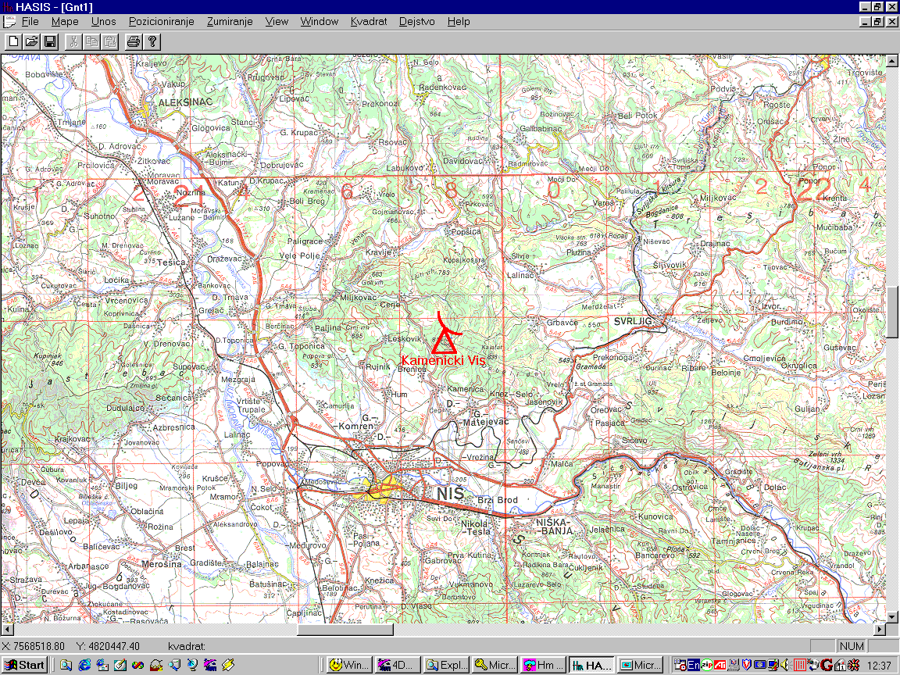
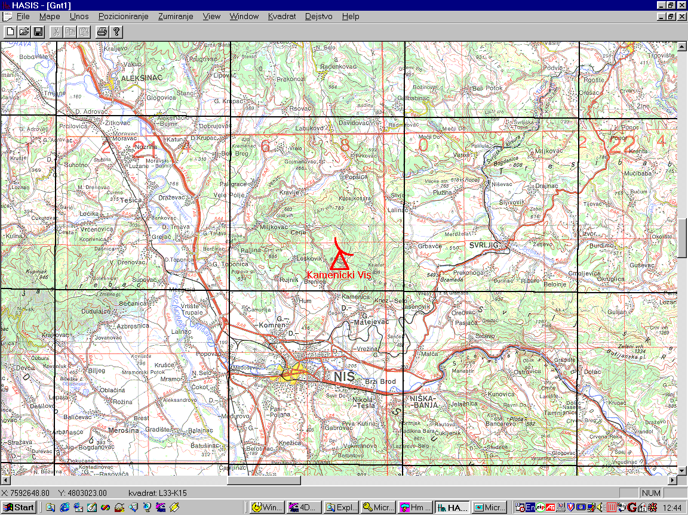
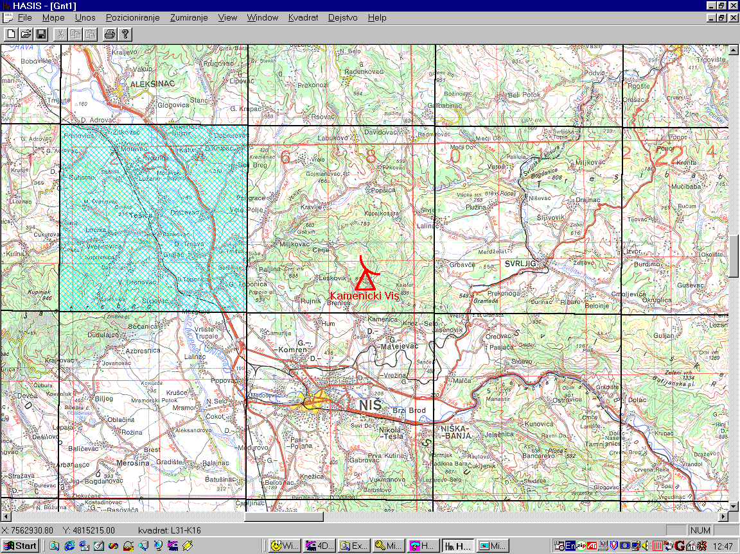
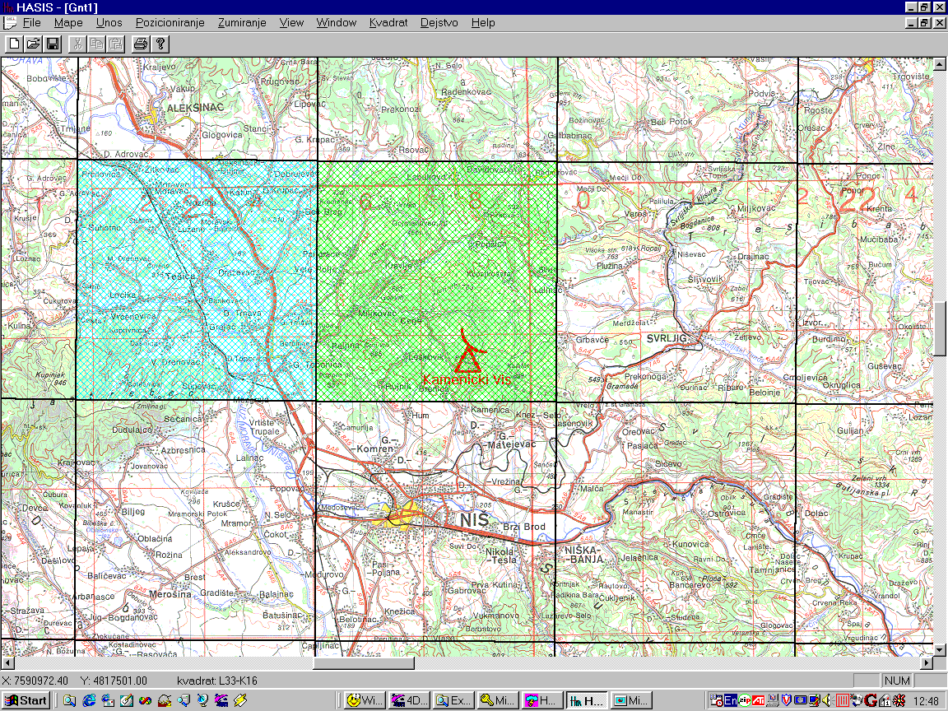
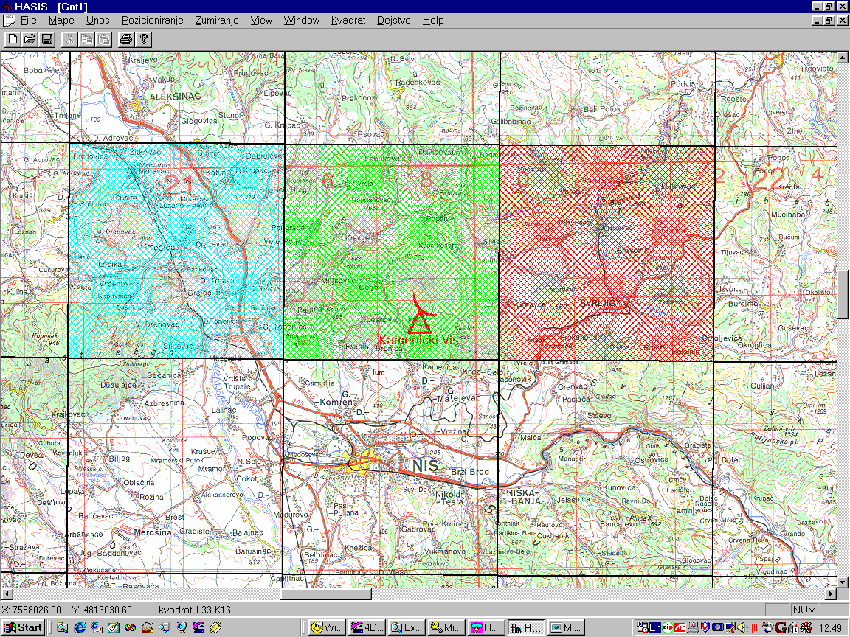
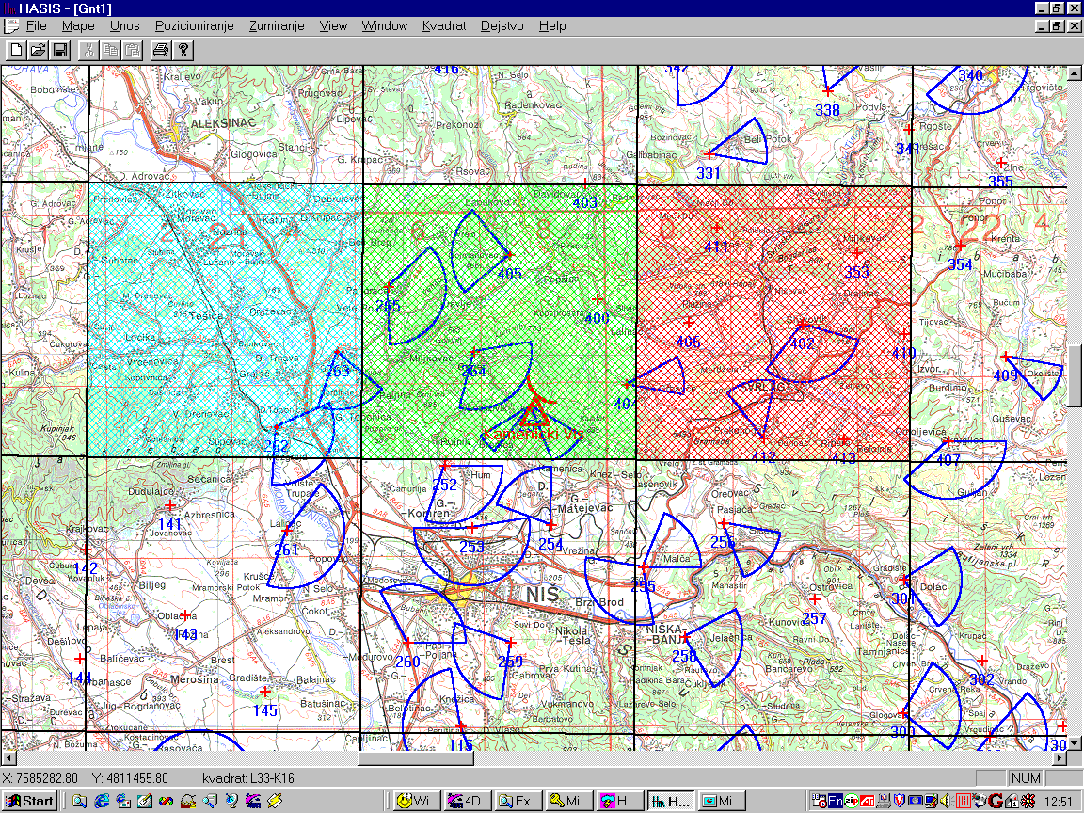
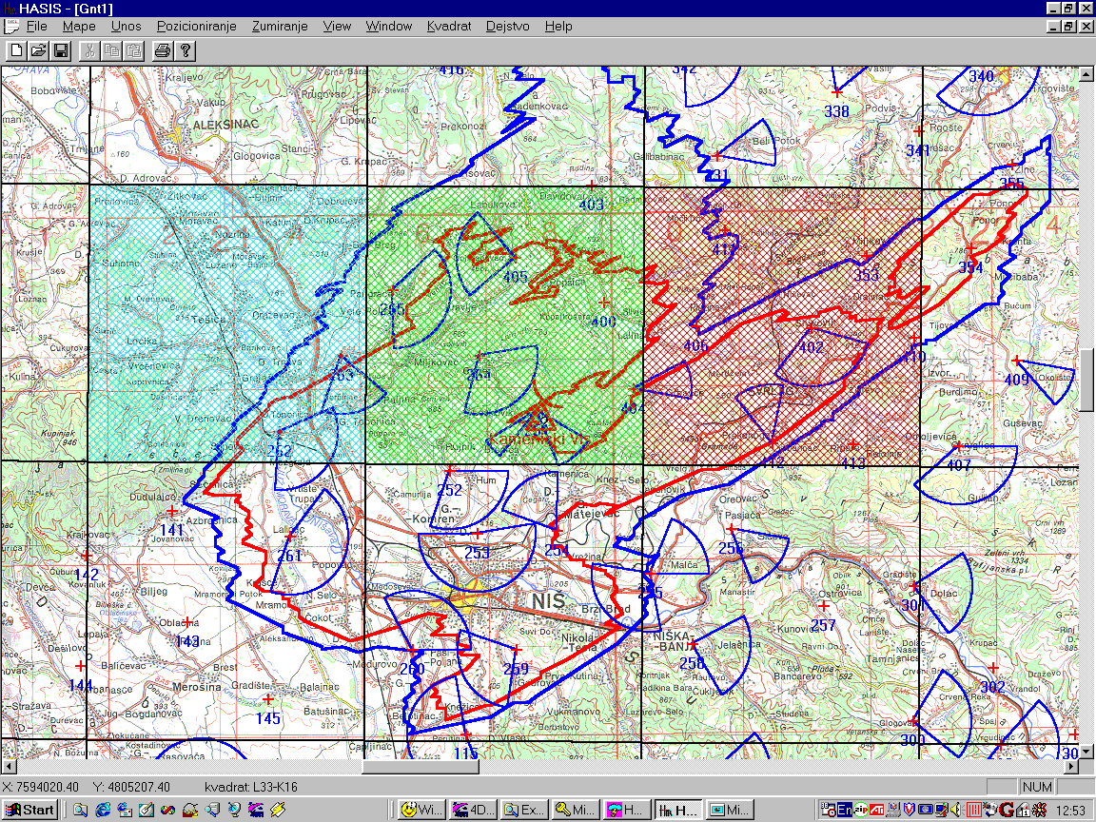
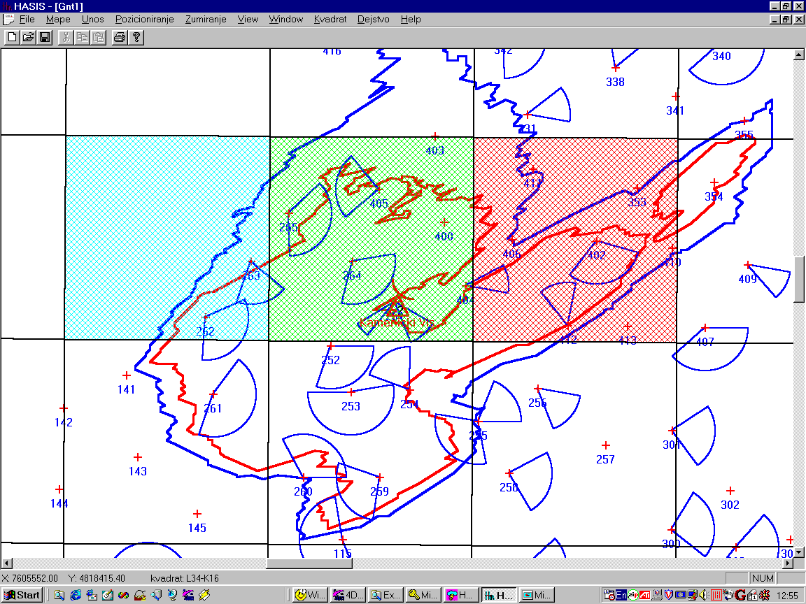
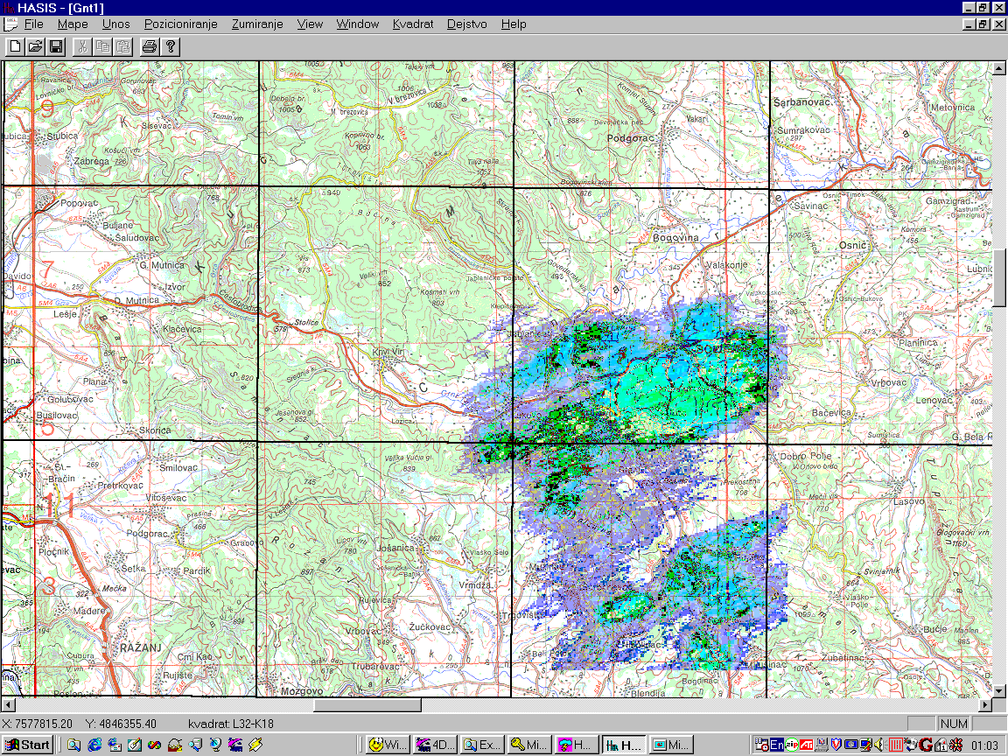
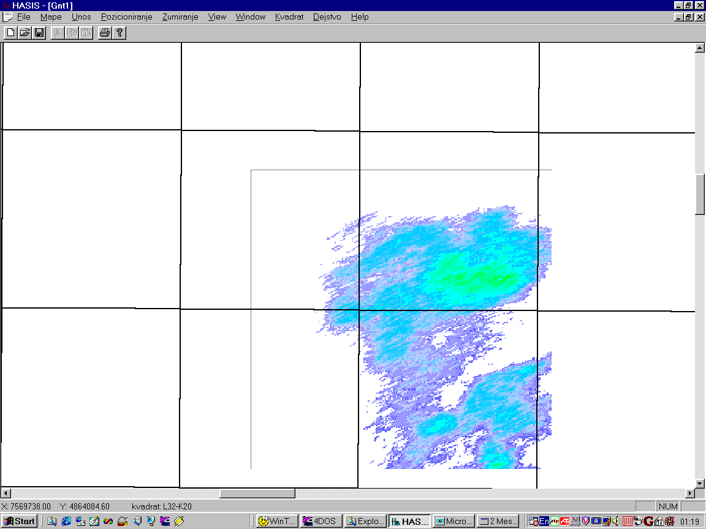
Raster map with vector layers

Slide 22
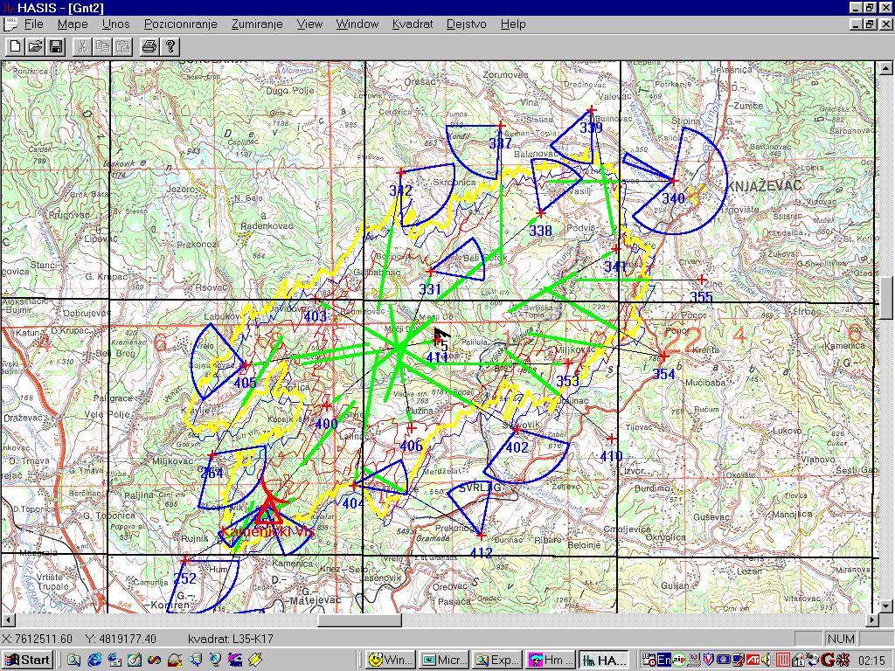
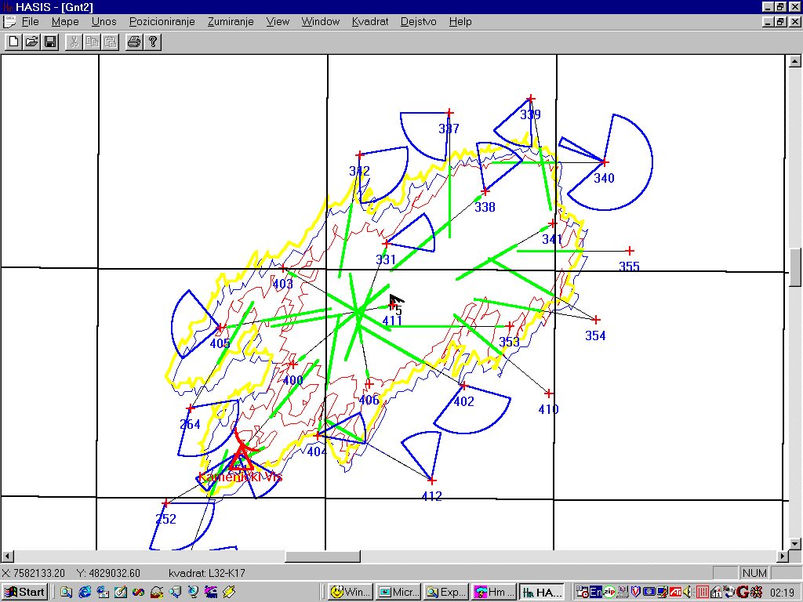
Cloud seeding

Slide 23

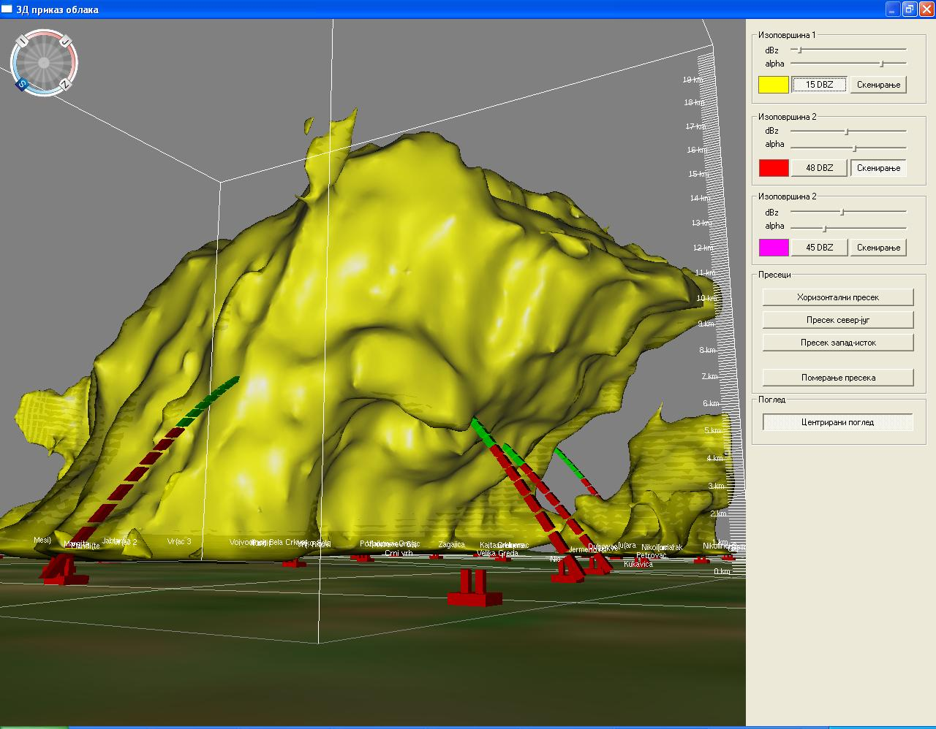
3D cloud visualization
Development of master curricula for natural disasters risk management in Western Balkan countries

Slide 24
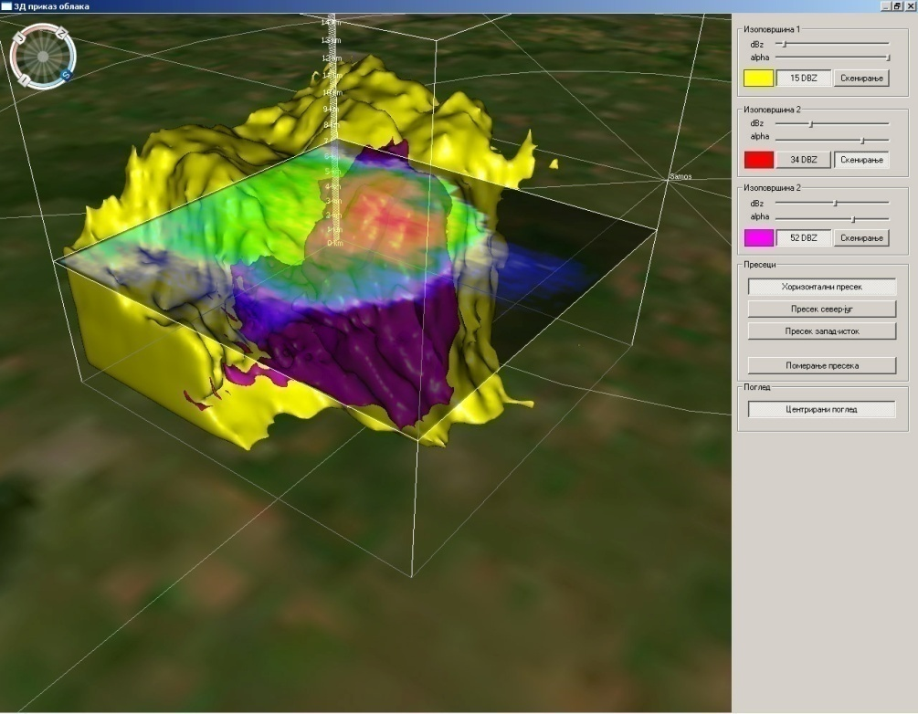
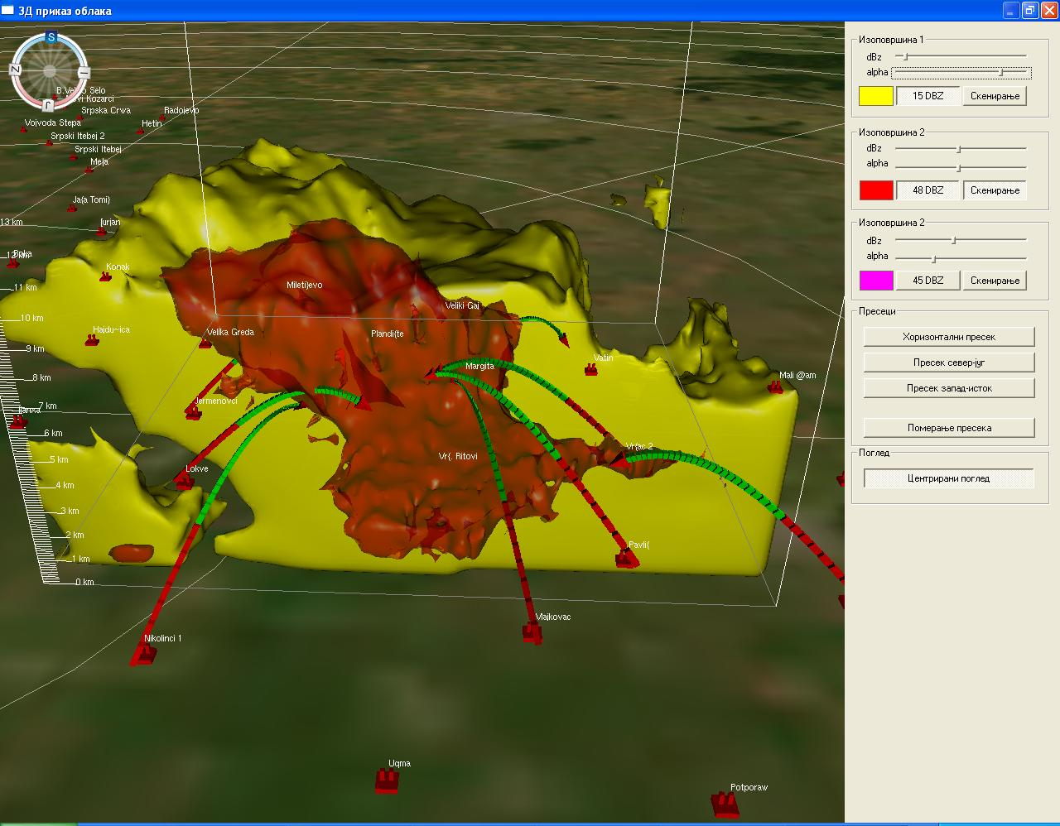
3D cloud visualization
Development of master curricula for natural disasters risk management in Western Balkan countries

Slide 25
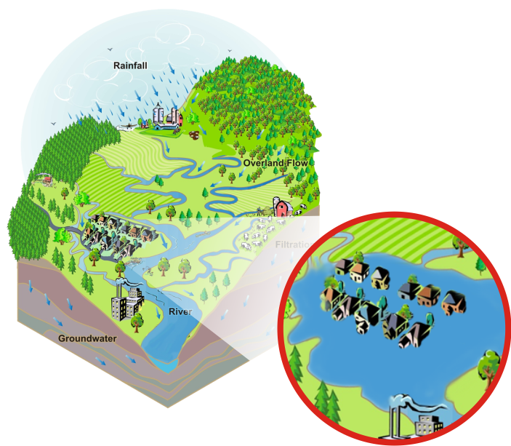
Flooding
Floods can be categorized as one of the most destructive environmental disasters.
Every year heavy rainfall damages different rural and urban areas.
Areas with High Flood Risk

Slide 26
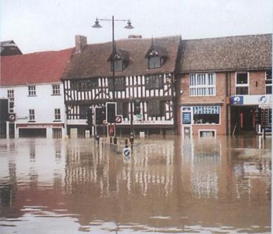
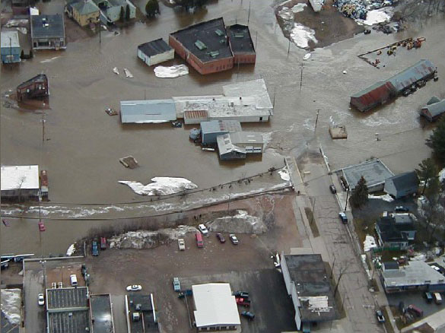
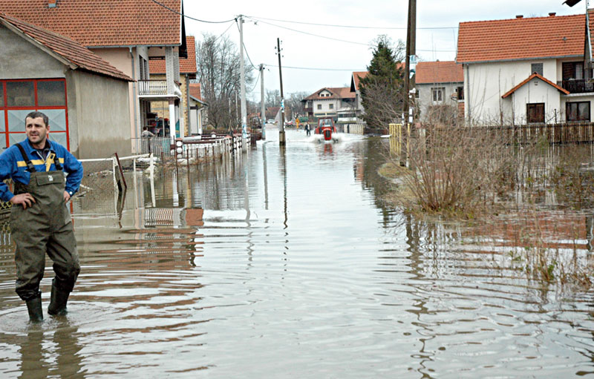
Flooding
The flood disaster results in tremendous damages to people and their belongings !!!

Slide 27

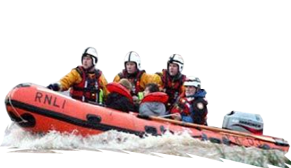

On-time flood prediction and alerting
With adequate sensing systems and developed hydro-meteorological model we can indicate probability for flooding and have on-time flood prediction and alerting.
Water Level and Precipitation Sensor Stations
HASIS 3D Radar Stations, (Vertically Integrated Liquid) VIL products

Slide 28
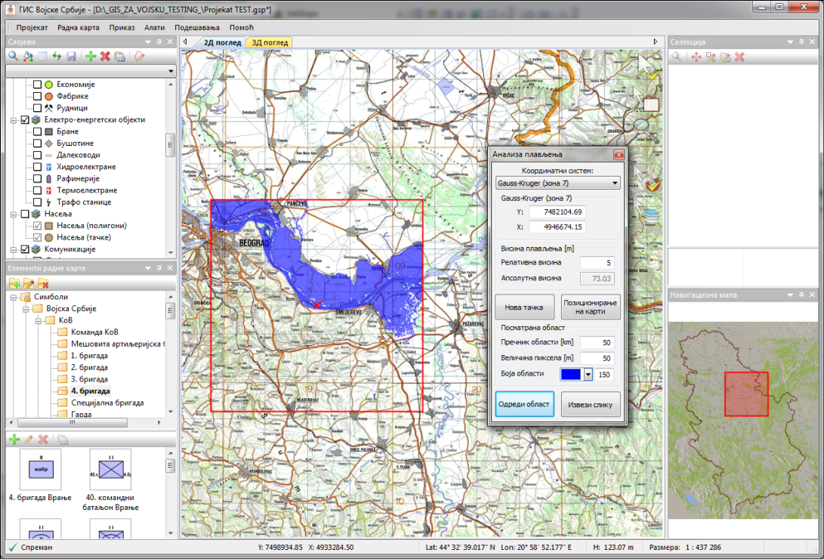
Development of master curricula for natural disasters risk management in Western Balkan countries
Flooding analysis
Flexible and powerful tool for flooded area calculation.
User friendly interface.
Numerous parameters enable fine tuning of the calculation process.
Export of the analysis result to georeferenced PNG file.
Following parameters will be user adjustable:
-coordinates of the initial point of the flood
-water level increase in the initial point
-area size
-pixel size
-display color and transparency of calculated flooded area
Initial point coordinates input:
Mouse input – directly on the map
Keyboard input – entering coordinates in appropriate text boxes of the flood analysis dialog

Slide 29
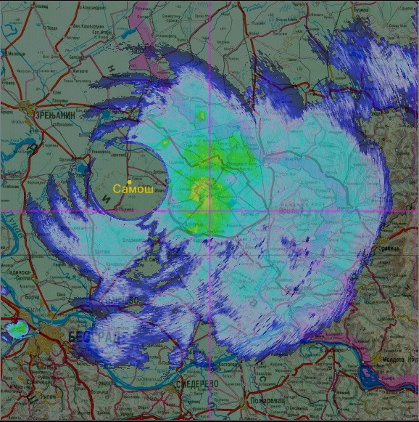
Vertically Integrated Liquid - VIL
HASIS 3D software collects radar data and creates VIL (vertically integrated liquid) water product for selected area.
This product is being sent to GinisSense DMA (Decision Making Agent) component for further analysis. DMA is a component within the GinisSense system that makes flood prediction on the basis of defined hydro-meteorological model, VIL data received from radars, gathered sensor data and database of rules. DMA calculates flood risk. If the calculated risk is higher than permissible level, system will immediately alert registered users.

Slide 30
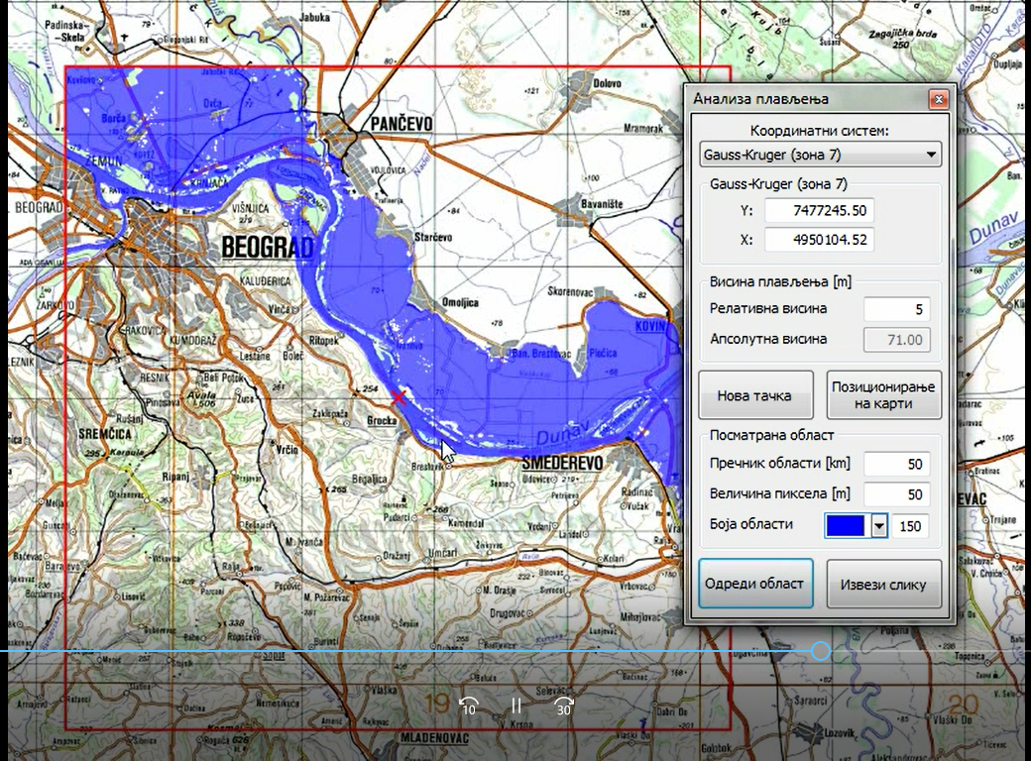
Ministry of Defence – GIS for natural hazards prevention
Development of master curricula for natural disasters risk management in Western Balkan countries

Slide 31
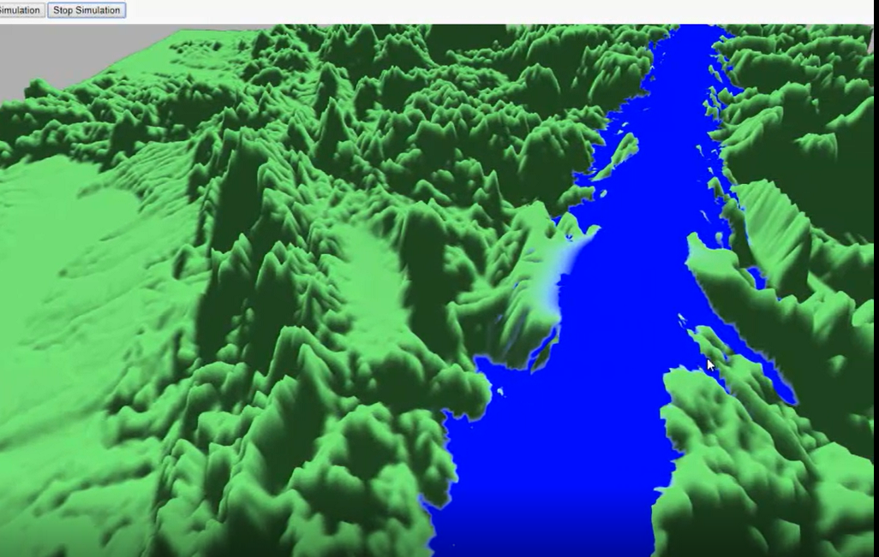
Ministry of Defence – GIS for natural hazards prevention
Development of master curricula for natural disasters risk management in Western Balkan countries

Slide 32
Conclusion
Development of master curricula for natural disasters risk management in Western Balkan countries
Cloud monitoring and tracking
  Different types of radar product are visualized.
  Accurate isosurface representation.
Detecting cloud with high probability of hail in early phases
  Efficient radar data conversion and visualization.
  Shorten time to make decision of seeding the potentially dangerous clouds.
Automatic calculation for cloud seeding
  Automatic and near optimal selection of hail suppression station that will seed the hail cloud and the parameters to launch the rockets.
  The possibility that operator will make error is minimized.
GIS for natural hazards prevention.

Slide 33
Thanks for your attention!!!
Development of master curricula for natural disasters risk management in Western Balkan countries

